Slide 1
Programming in C
BICT 1202

Slide 2
C Language Overview
General-purpose, high-level language
Developed by Dennis M. Ritchie.
First implemented on the DEC PDP-11 computer in 1972.
In 1978, first publicly available description of C produced.
The K&R standard.
Widely used professional language for various reasons:
Easy to learn
Structured language
Efficient programs.
Low-level activities.
Platform independent.

Slide 3
Characteristics of C programming
1. Simplicity
2. Clarity
3. Portability
4. Modularity
5. Easy Availability

Slide 4
C Programs
A C program can vary from 3 lines to millions of lines.
Written into a text file.
With extension ".c“.
E.g. hello.c.
Use a text editor to write your C program into a file.

Slide 5
C Environment Setup
(a) Text Editor
Used to type your program.
Examples
Windows Notepad, OS Edit command, Brief, Epsilon, EMACS, and vim or vi.
Source files created
Contain program source code.
Extension “.c”.

Slide 6
C Environment Setup
(b) The C Compiler
Source code
Is the human readable source for your program.
It needs to be "compiled“
Execute the program
CPU
Most frequently used and free available compiler
GNU C/C++ compiler.

Slide 7
C Program Structure
A C program basically consists of the following parts:
Preprocessor Commands
Functions
Variables
Statements & Expressions
Comments
Example of a simple code that print the words "Hello World":

Slide 8
#include <stdio.h>
int main()
{
/* my first program in C */
printf("Hello, World! \n");
return 0;
}

Slide 9
Let us look at various parts of the above program:
1. The first line of the program #include <stdio.h>
is a directive to the C preprocessor. Lines beginning with # are processed by the preprocessor before the program is compiled.
Tells the preprocessor to include the contents of the standard input/output header (<stdio.h>) in the program.
This header contains information used by the compiler when compiling calls to standard input/output library functions such as printf

Slide 10
Let us at look various parts of the above program:
2. The next line int main()
is a part of every C program. The parentheses after main indicate that main is a program building block called a function.
C programs contain one or more functions, one of which must be main. Every program in C begins executing at the function main.
Functions can return information. The keyword int to the left of main indicates that main “returns” an integer (whole number) value
The main function has a body which starts with an opening curly brace/ bracket and has a closing curly brace/bracket

Slide 11
Let us look at various parts of the above program:
3. The next line /*...*/
Will be ignored by the compiler and it has been put to add additional comments in the program.
So such lines are called comments in the program.

Slide 12
Let us look various parts of the above program:
The next line printf(“Welcome to C!\n");
instructs the computer to perform an action, namely to print on the screen the string of characters marked by the quotation marks. A string is sometimes called a character string, a message or a literal.
The entire line, including printf, its argument within the parentheses and the semicolon (;), is called a statement. Every statement must end with a semicolon (also known as the statement terminator).
When the preceding printf statement is executed, it prints the message Welcome to C! on the screen.

Slide 13
Let us look at various parts of the above program:
5. The next line return 0;
is included at the end of every main function. The keyword return is one of several means we’ll use to exit a function.
When the return statement is used at the end of main as shown here, the value 0 indicates that the program has terminated successfully.

Slide 14
C Basic Syntax
You have seen a basic structure of C program, so it will be easy to understand other basic building blocks of the C programming language.
Tokens in C
A C program consists of various tokens.
A token is either a keyword, an identifier, a constant, a string literal, or a symbol.

Slide 15
C Basic Syntax
For example, the following C statement consists of five tokens:
printf("Hello, World! \n");
The individual tokens are:
1. printf 2. (
3. "Hello, World! \n" 4. )
5. ;
STUDY MORE ABOUT TOKENS

Slide 16
Semicolons ;
In C program, the semicolon is a statement terminator.
That is, each individual statement must be ended with a semicolon.
It indicates the end of one logical entity.
For example, following are two different statements:
printf("Hello, World! \n"); return 0;

Slide 17
Comments
Comments are like helping text in your C program and they are ignored by the compiler.
They provide clarity to the C source code allowing others to better understand what the code was intended to accomplish and greatly helping in debugging the code.
Comments are especially important in large projects containing hundreds or thousands of lines of source code or in projects in which many contributors are working on the source code
They start with a slash asterisk (/*) and terminates with the asterisk slash (*/) as shown below:
/* my first program in C */
You cannot have comments within comments and they do not occur within a string or character literals.

Slide 18
Comments
There are two types of comments in C programming
multiple line comments
• /* */
Can also be used as a single line as long as the comment(s) don’t span more than one line.
And single line comments
introduced by C++;
double slashes (//);
this is used with modern C compilers if they also understand the C++ language.

Slide 19
Identifiers
A C identifier is a name used to identify a variable, function, or any other user-defined item.
An identifier starts with a letter A to Z or a to z or an underscore ( _ )
followed by zero or more letters, underscores, and digits (0 to 9).
C does not allow punctuation characters such as @, $, and % within identifiers.
C is a case sensitive programming language.
Thus, Manpower and manpower are two different identifiers in C.
Here are some examples of acceptable identifiers:
Mohd, zara, abc, move_name, a_123, myname50, _temp, j, a23b9, retVal.

Slide 20
Keywords
The following list shows the reserved words in C.
The two words are used interchangeably i.e. keyword and reserved word
These reserved words may not be used as constant or variable or any other identifier names.
In a computer language, a reserved word AKA reserved identifier is a word that cannot be used as an identifier such as a name of a variable, function etc.
It is reserved from use.

Slide 21
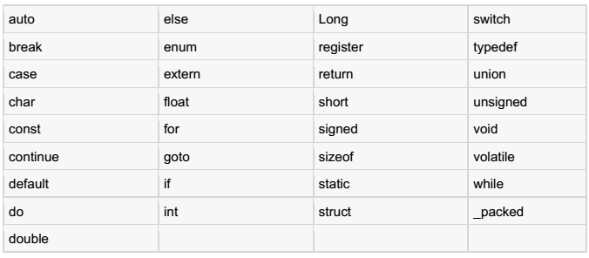
Keywords
Examples of key words

Slide 22
Whitespace in C
A line containing only whitespace, possibly with a comment, is known as a blank line, and
a C compiler totally ignores it.
Whitespace is the term used in C to describe blanks, tabs, newline characters and comments.
Whitespace separates one part of a statement from another and enables the compiler to
identify where one element in a statement, such as int, ends and the next element begins.
Therefore, in the following statement:
int age;
There must be at least one whitespace character (usually a space) between int and age for the compiler to be able to distinguish them.
On the other hand, in the following statement:
fruit = apples + oranges;
// get the total fruit
No whitespace characters are necessary between fruit and =, or between = and apples, although you are free to include some if you wish for readability purpose.

Slide 23
C Data Types
There are four basic data types as follows:
Data types simply refers to the type and size of data associated with variables and functions.
The type of a variable determines how much space it occupies in storage and how the bit pattern stored is interpreted.
1. Fundamental data types
Integer types
These are whole numbers that can have both positive and negative values but no decimal values. E.g 0,-5,10
The keyword int is used in C for declaring integer variable e.g int id
Here id is a variable of data type integer
You can declare multiple variables at once in C programming. E.g int id, age;
•

Slide 24
floating types
These can hold real numbers such as 2.34, -9.382, 5.0 etc.
You can declare a floating point variable in C by using either float or double keyword. E.g. float accountBalance; double bookPrice;
Here both variables are floating type variables.
The difference between the two is precision.
Float has single precision float data type (4 bytes; precision of 6 digits) and
double has double precision float data type (8 bytes; 14 digits precision)
Character types
Key word char is used for declaring character type variables.
E.g. char test=‘h’; here test is a character variable and its value is ‘h’
Other types also exist.
READ MORE ABOUT DATA TYPES IN C

Slide 25
C Variables
A variable is nothing but a name given to a storage area that our
programs can manipulate.
Each variable in C has a specific type, which determines
the size and layout of the variable's memory;
the range of values that can be stored within that memory; and
the set of operations that can be applied to the variable.
The name of a variable can be composed of letters, digits, and the underscore character.
It must begin with either a letter or an underscore.
Upper and lowercase letters are distinct because C is case-sensitive.

Slide 26
Variable Definition in C:
A variable definition means to tell the compiler where and how much to create the storage for the variable.
A variable definition specifies a data type and contains a list of one or
more variables of that type as follows:
type variable_list;
The line int i, j, k; both declares and defines the variables i, j and k; which instructs the compiler to create variables named i, j and k of type int.

Slide 27
Variable Initialisation
Variables can be initialized (assigned an initial value) in their
declaration.
The initializer consists of an equal sign followed by a constant expression as follows:
type variable_name = value;
For definition without an initializer: variables with static storage duration are implicitly (indirectly) initialized with NULL (all bytes have the value 0);
the initial value of all other variables is undefined.

Slide 28
Example
#include <stdio.h>
// Variable definition:
extern int a, b;
extern int c;
extern float f;
int main ()
• {

Slide 29
// Variable definition:
int a, b;
int c;
float f;
// actual initialization
• a =10;
• b =20;
c = a + b;
printf("value of c : %d \n", c);
• f = 70.0/3.0;
printf("value of f : %f \n", f);
return 0;
• }

Slide 30
Lvalues and Rvalues in C
There are two kinds of expressions in C:
1. lvalue
An expression that is an lvalue may appear as either the left-hand or right-hand side of an
assignment.
2. Rvalue
An expression that is an rvalue may appear on the right- but not left-hand side of an assignment.
Variables are lvalues and so may appear on the left-hand side of an assignment.
Numeric literals are rvalues and so may not be assigned and cannot appear on the left-hand side.
Following is a valid statement:
int g = 20;
But following is not a valid statement and would generate compile-time error:
• 10 = 20;

Slide 31
C Constants and Literals
The constants refer to fixed values that the program may not alter
during its execution.
These fixed values are also called literals.
Constants can be of any of the basic data types like an integer
constant, a floating constant, a character constant, or a string literal.
The constants are treated just like regular variables except that their values cannot be modified after their definition.

Slide 32
Character constants
Character literals are enclosed in single quotes, e.g., 'x' and can be
stored in a simple variable of char type.
A character literal can be a plain character (e.g., 'x'), an escape sequence (e.g., '\t'), or a universal character (e.g., '\u02C0').
There are certain characters in C when they are preceded by a backslash they will have special meaning and they are used to represent like newline (\n) or tab (\t).
Here, you have a list of some of such escape sequence codes:

Slide 33
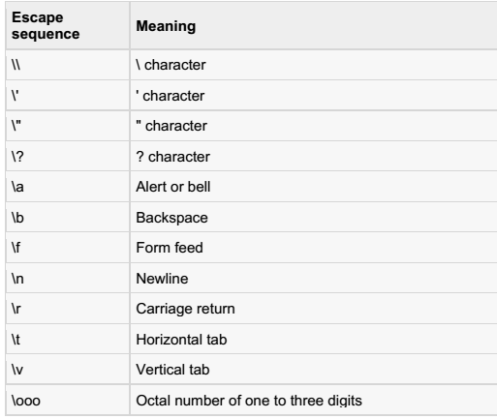

Slide 34
Following is the example to show few escape sequence characters:
#include <stdio.h>
int main()
{
printf("Hello\tWorld\n\n");
return 0;
}
When the above code is compiled and executed, it produces the
following result:
Hello World

Slide 35
String literals
String literals or constants are enclosed in double quotes "".
A string contains characters that are similar to character literals: plain characters, escape sequences, and universal characters.
You can break a long line into multiple lines using string literals and separating them using whitespaces.
Here are some examples of string literals.
"hello, dear"
"hello, \
dear"
All the two forms are identical strings.

Slide 36
Defining Constants
1. Using #define preprocessor.
2. Using const keyword.

Slide 37
The #define Preprocessor
Takes the form:
#define identifier value
Example
#include <stdio.h>
#define LENGTH 10
#define WIDTH 5
#define NEWLINE '\n'
int main()
• {
int area;
area = LENGTH * WIDTH;
printf("value of area : %d", area);
printf("%c", NEWLINE);
return 0;
• }

Slide 38
The const Keyword
const type variable = value;
Example
#include <stdio.h>
int main()
• {
const int LENGTH = 10;
const int WIDTH = 5;
const char NEWLINE = '\n';
int area;
area = LENGTH * WIDTH;
printf("value of area : %d", area);
printf("%c", NEWLINE);
return 0;
• }
Note that it is a good programming practice to define constants in CAPITALS.

Slide 39
Storage Class
A storage class defines the scope (visibility) and life-time of variables and/or functions within a C Program. precede the type that they modify.
We have four different storage classes in a C program −
Auto
Register
Static
extern

Slide 40
The auto Storage Class
The auto storage class is the default storage class for all local variables.
{
int mount;
auto int age;
}
The example above defines two variables with in the same storage class. 'auto' can only be used within functions, i.e., local variables.

Slide 41
The register Storage Class
The register storage class is used to define local variables that should be stored in a register instead of RAM. This means that the variable has a maximum size equal to the register size (usually one word) and can't have the unary '&' operator applied to it (as it does not have a memory location).
{
register int miles;
}
The register should only be used for variables that require quick access such as counters. It should also be noted that defining 'register' does not mean that the variable will be stored in a register. It means that it MIGHT be stored in a register depending on hardware and implementation restrictions.

Slide 42
The static Storage Class
The static storage class instructs the compiler to keep a local variable in existence during the life-time of the program instead of creating and destroying it each time it comes into and goes out of scope. Therefore, making local variables static allows them to maintain their values between function calls.
The static modifier may also be applied to global variables. When this is done, it causes that variable's scope to be restricted to the file in which it is declared.
In C programming, when static is used on a global variable, it causes only one copy of that member to be shared by all the objects of its class.

Slide 43
The extern Storage Class
The extern storage class is used to give a reference of a global variable that is visible to ALL the program files.
When you use 'extern', the variable cannot be initialized however, it points the variable name at a storage location that has been previously defined.
When you have multiple files and you define a global variable or function, which will also be used in other files, then extern will be used in another file to provide the reference of defined variable or function.
Just for understanding, extern is used to declare a global variable or function in another file.

Slide 44
The extern Storage Class
The extern modifier is most commonly used when there are two or more files sharing the same global variables or functions as explained below.
File: main.c
#include <stdio.h>
int count ;
extern void write_extern();
main()
{
count = 5;
write_extern();
}

Slide 45
The extern Storage Class
The extern modifier is most commonly used when there are two or more files sharing the same global variables or functions as explained below.
Second File: support.c
#include <stdio.h>
extern int count;
void write_extern(void)
{
printf("count is %d\n", count);
}
Here, extern is being used to declare count in the second file, where as it has its definition in the first file, main.c.

Slide 46
C - Operators
An operator is a symbol that tells the compiler to perform specific mathematical or logical functions. C language is rich in built-in operators and provides the following types of operators −
Arithmetic Operators
Relational Operators
Logical Operators
Bitwise Operators
Assignment Operators
Misc Operators (miscellaneous)

Slide 47
Arithmetic Operators
Name addition subtraction
multiplication division
Symbol
+
-
*
/
Sample usage
int sum = 4 + 7
float difference = 18.55 - 14.21
float product = 5 * 3.5
int quotient = 14 / 3
int remainder = 10 % 6
modulo ("mod")
%

Slide 48





Incremental / Decrement Operators
Name | Symbol | Sample usage
Increment Operator | ++ | ++a or a++
Decrement Operator | -- | --a or a--

Slide 49


The increment operator , ++, adds 1 to its operand and -- subtracts 1 from its operands. That is a=++a is equal to a=a+1 and b=--b is equal to b=b-1.
(With the prefix version of these operators, C performs the
increment or decrement operation before using the value of the operand.

Slide 50




Relational Operators
Relational operators determine the relation among different operands. C provides 6 relation operators for comparing numbers and characters ( but not strings). If the comparison is true, the relational expression returns 1 and to 0, if the comparison in false

Slide 51
Relational Operators
Name | Symbol | Sample usage | Result
is less than | < | bool result = (4 < 7) | true
is greater than | > | bool result = (3.1 > 3.1) | false
is equal to | == | bool result = (11 == 8) | false
is less than or equal to | <= | bool result = (41.1 <= 42) | true
is greater than or equal to | >= | bool result = (41.1 >= 42) | false
is not equal to | != | bool result = (12 != 12) | false

Slide 52



Logical Operators
C provides three logical operators to combine existing expression.
Name | Symbol | Sample usage
logical OR | || | (4= =4) || (5++5)
logical AND | && | a>b && c>d
logical NOT | ! | !(0)

Slide 53
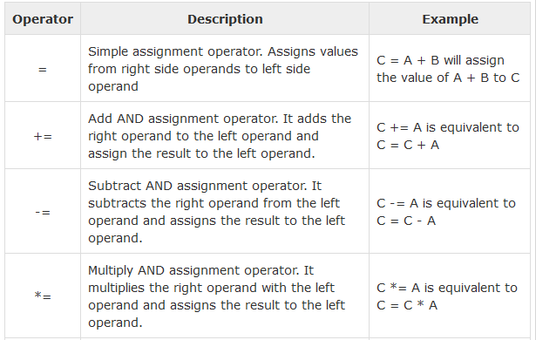
Assignment Operators
The following table lists the assignment operators supported by the C language

Slide 54
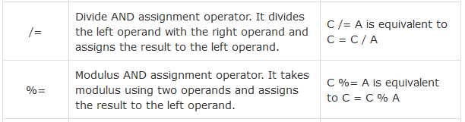
Assignment Operators
The following table lists the assignment operators supported by the C language

Slide 55
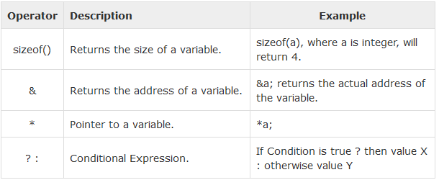
Misc Operators
The following table lists the miscellaneous operators supported by the C language

Slide 56
Operators Precedence in C
Operator precedence determines the grouping of terms in an expression and decides how an expression is evaluated.
Certain operators have higher precedence than others; for example, the multiplication operator has a higher precedence than the addition operator.
For example, x = 7 + 3 * 2; here, x is assigned 13, not 20 because operator * has a higher precedence than +, so it first gets multiplied with 3*2 and then adds into 7.

Slide 57
Exercise
Write a C program that asks the user to enter his/her first name, last name, gender and age. The program then should print a summary of what a user entered.

